Slide 1
From technical to strategic agility
Jess Panni
Lead Consultant
jess.panni@readify.net
@jesspanni
Rob Moore
Lead Consultant
rob.moore@readify.net
@robdmoore
Notes:
Introduce ourselves
RM:
Our goal for this talk is to illustrate where we think the industry is heading, why it’s important and some of the things we can all do to move in the right direction.

Slide 2

Notes:
RM
We don’t claim to be experts in what we are presenting; we're on a journey to try and discover ways of delivering more value more efficiently.
This talk will cover our research, learnings and ideas.
We hope this is a thought provoking talk.

Slide 3
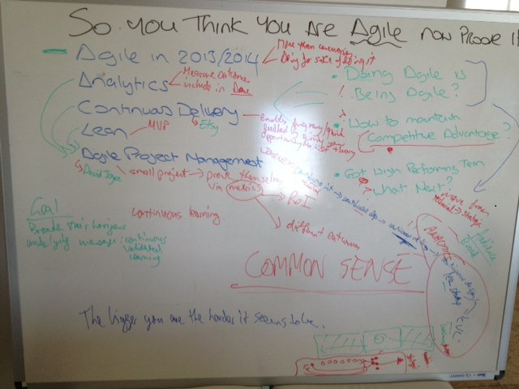
Notes:
JP
Point out common sense
or is it.. why do we keep making the same mistakes?
Perhaps It’s uncommon sense!

Slide 4
What we see today…
Planning
Development
Release/Post Release
Waterfall
High Performing Agile Team (technical agility)
Waterfall
Scrumfall
Notes:
JP:
We’re often brought into organisations who are struggling with software development and generally this is what we see.
[Transition]
Most development teams start by focusing on the practices of agile.
They assign a Product Owner & Scrum Master. They work iteratively against a backlog and agile ceremonies are followed and Velocity is religiously tracked. We also see teams starting to adopt agile engineering principles, they write unit tests, setup build servers and may even practice TDD and Pair Programming.
At this stage they often do not get the true benefit of agile as they tend to focus on following processes and get caught up in religious agile debate. Rather than embracing the different culture and thinking of Agile teams at this stage are essentially working the same way they always have, but with some different processes.
We are generally able to work with teams over time and with the right people and hard work they will eventually become a high performing Agile team.
[Transition]
A team who focuses on delivering desired OUTCOMES and by addressing right technical PROBLEMS though Continuous Improvement. They understand each other and work to the strengths and weaknesses of the individuals in the team. And importantly, the team will have changed their culture and will approach all problems with an Agile mindset.
This can be likened to what Bruce Tuckman observed in his 4 phases of team dynamics: Forming -> Storming -> Norming -> Performing (See reference at end of deck)
-----
RM:
But, if you look outside the development team you will often find that:
[Transition]
Traditional software development management practices book-end the great work the Agile teams deliver.
We see this in almost every organisation that we go into. The initial planning cycle will involve defining and scheduling large projects with large budgets and expectations are set as if everything is known up front about the needs and outcomes of the project.
At first the development team is free to practice agile as they see fit, but as the project progresses the business often puts more and more pressure on the team to deliver to the original plan. This is despite the fact that the team will have made a number of learnings about the project over that time that completely invalidate the original plan.
And then after the development team has done their awesome work it gets even worse as organisations are often reluctant to QA and release until the project is nearing completion – again to fit in with the original plan. The project is often considered complete when the plan ends which is often at the point the software is handed over to the operations and support team to deploy and maintain.
There are two main problems with this:
A divide forms between the development team and the operations team, which causes a whole raft of issues that make it hard to efficiently support and modify your software – this is what the dev ops movement tries to address and we encourage you read up about that (see reference at end of deck)
Also, the project is considered successful if at its closure its on time and on budget, but more importantly the true success is whether the desired outcomes of that project were met – how can you know a project is successful if the end of the project doesn’t measure the outcome of real-world usage?
All these behaviours promote AND REWARD non-agile thinking and make it hard for organisations to truly realise the potential business and strategic value that their Agile teams could be delivering.

Slide 5

ENABLING
BUSINESS AGILITY
Notes:
RM
More and more techniques are emerging, and becoming commonplace, that remove technical hurdles to and empower more agility in how software is specified and designed by product owners.

Slide 6
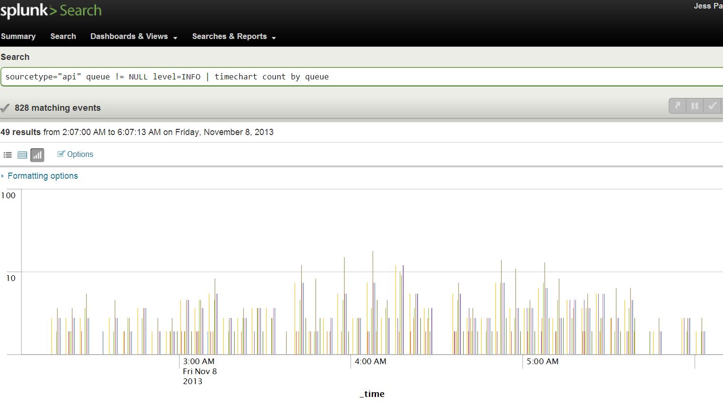
Continuous Integration
Dev Ops
Technical Metrics
Notes:
RM

Slide 7
“reduc[ing] the cost, time, and risk of delivering incremental changes to users”
Continuous Delivery
Jezz Humble
Principal Consultant, ThoughtWorks
Notes:
RM
A really important approach that has recently emerged is the practice of continuous delivery. According to Jezz Humble, who coined that term and wrote a book on the subject, continuous delivery is:
“reduc[ing] the cost, time, and risk of delivering incremental changes to users”
More specifically it involves ensuring software is constantly in a releasable state on demand and reducing risk by creating confidence and repeatability to take commits that developers push through a consistent, largely automated deployment pipeline to eventually get to production.
It’s important to note that continuous delivery implies cultural change for not only the development team, but operations, project management and product ownership.
While the end result is worth it, it’s not easy to implement and Jezz says in his presentations that it takes AT LEAST 12 months to implement in an organisation. Our experiences in implementing continuous delivery so far confirms that kind of timeframe.
So what kind of behaviours does the implementation of this type of approach yield from the business?
Deploying changes to production become a business decision rather than an IT decision
From our experiences this type of approach leads to the business having more confidence and excitement in releasing software and empowers them to release small changes often at the click of a button as a cheap, easy way to learn something
This allows the business to reduce feedback loops on measuring how end users use the features they are prioritising and take advantage of design techniques like A/B testing
Ultimately, this lets the business learn what makes the product great rather than having to guess when devising and prioritising the product backlog

Slide 8
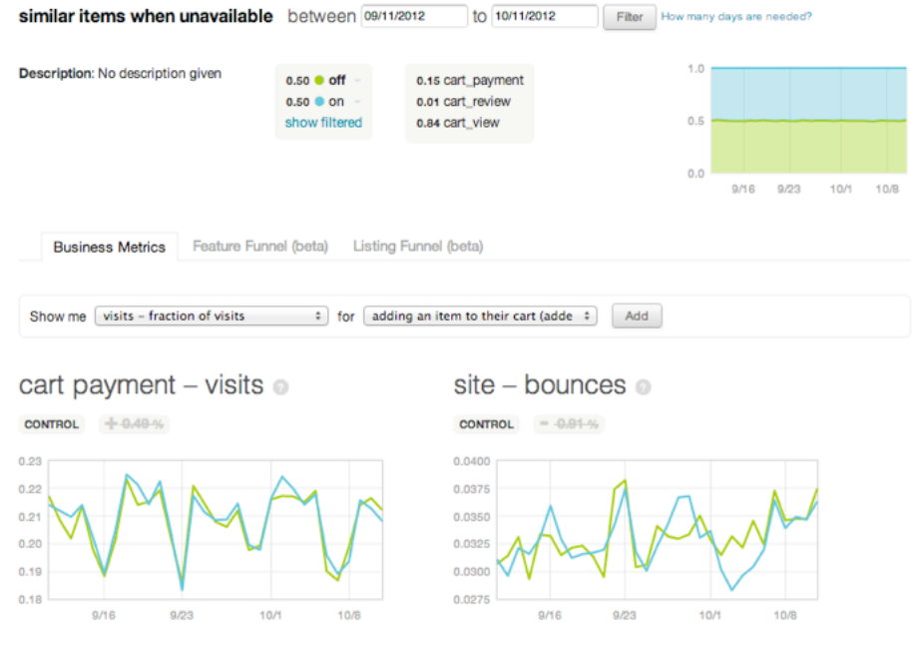



Usage analytics
A/B testing
Feature Toggles
Notes:
http://qconsf.com/sf2012/dl/qcon-sanfran-2012/slides/FrankHarris_and_NellThomas_ProductDevelopmentWithContinuousExperimentation.pdf
RM

Slide 9
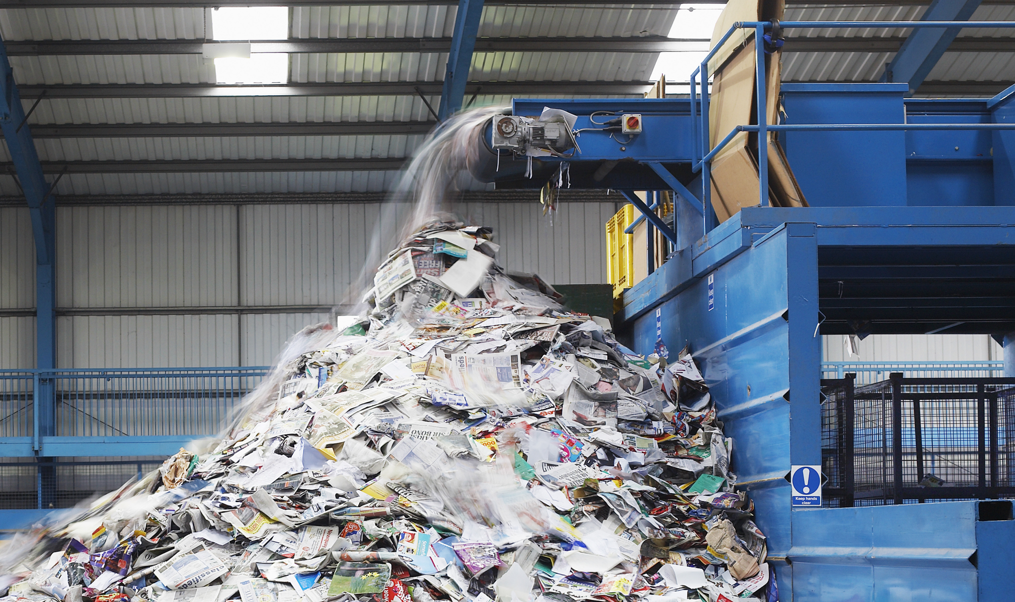
Notes:
JP
Development teams are getting better and better at developing and delivering software.
But... Biggest form of waste is delivering the wrong thing....
Wasted time building something that will not realize expected value
Opportunity cost - time we could have spent delivering a better product
Operational cost - deployment, maintenance, unnecessary code etc.
Competitive Advantage / Big Opportunity

Slide 10
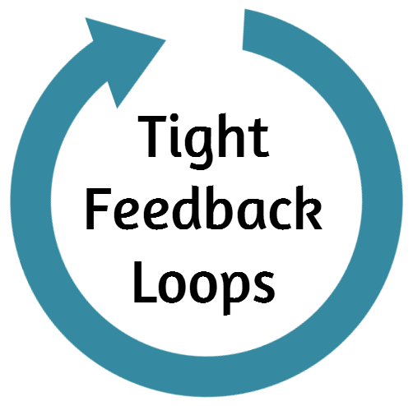
TECHNICAL
Continuous Integration
Deployment Pipelines
Technical Metrics
BUSINESS
A/B Testing
Continuous Delivery
Usage Analytics
STRATEGIC
?
?
Business Goals!
Notes:
JP

Slide 11
TECHNICAL
Continuous Integration
Deployment Pipelines
Technical Metrics
BUSINESS
A/B Testing
Continuous Delivery
Usage Analytics
STRATEGIC
?
?
Business Goals!
Notes:
JP

Slide 12

Randall Munroe (xkcd.com)
Notes:
JP
Back to Basics - The Science of Software Development (JP)
Scientific management pricipals have been around since the early 1900's not new
Ideas and opinions are regarded as being faliable.
Modern day versions:
Iterative Development
Scrum - Empirical
Continuous Validated Learning - Lean Startup - Strategic

Slide 13

“If we allow ourselves to be governed by opinion where it is possible to obtain facts, we shall lose in our competition with those who base their actions on facts.
Henry Lawrence Gannt Industrial Leadership, 1915
“A little consideration will show that such a policy is only in accord with common sense, and that the policy of insisting that a man shall do a thing, when we do not know whether he can do it or not, is, to say the least, not productive of the best results.
Notes:
JP

Slide 14
Unscientific Behaviours
Tenacity
AUTHORITY
CONFORMITY
Notes:
JP
Tenacity - people absorbed in their own belief not willing to accept or adapt when presented with contrary information
Authority - We are told what to believe even if deep down we don't believe it.
Conformity - Cos everyone else is doing it - fashionable.

Slide 15

Cultural Change
Notes:
RM
What we are talking about here is absolutely cultural change – it’s a completely different way of thinking about management and planning.
We’ve reached the conclusion through experience and some reasoning that in order to pull this off you need to involve executive management at the top of the chain for two reasons:
To change the culture of an entire company you clearly need to drive that with help from executives (think authority unscientific thinking)
In order to drive all decisions and actions in a company from the strategic goals you need the people who set the strategic goals to cooperate
If this "movement" was to start with only one person we believe it has to be someone at the top of the food chain.
Reiterate: It's not easy and it does take years - look at BankWest as an example.

Slide 16
Ideas and techniques that encourage strategic 'common sense' thinking....
Notes:
RM

Slide 17
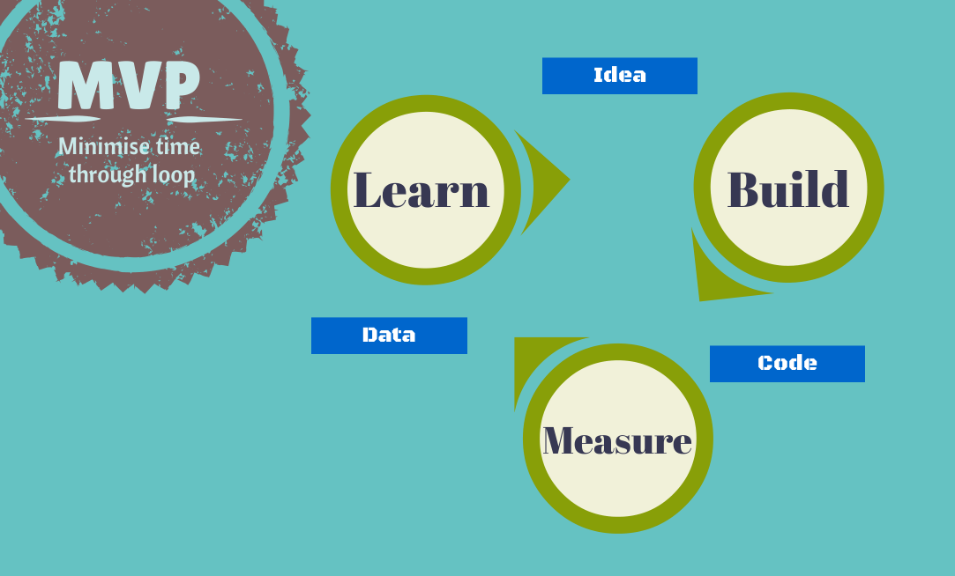
MVP
Notes:
RM
Lean Startup introduces the concept of the Build, Measure, Learn loop. Basically this means [explain the loop]
Lean Startup also introduces the concept of a minimum viable product as that version of a product which allows a team to collect the maximum amount of validated learning with the least amount of effort.
This might involve hours or days of effort or it might be days or weeks of effort – it depends entirely on what you are building, what hypothesis you are trying to test and the customers you are targeting.
Where we believe the MVP technique fits into strategic thinking is that we believe that minimum viable products should become a unit of measurement for strategic planning.
This comes back to what we presented at the start about the work of Agile teams being book-ended by waterfall planning and release. If instead of planning big projects if companies instead identified minimum viable products that may help the company meet a strategic goal then this presents a much lower risk profile for the company.
To illustrate, say a company has one important strategic goal they want to meet for a 6 month period of time – increase membership by 20%. If they scheduled a 6 month project and it turns out that project isn’t successful in meeting that goal then there is no opportunity to correct for that until after the 6 months is up. If instead the company identified a series of MVPs (let’s say 6 MVPs) then there is 6 times the learning and it’s much more likely that in that time an approach that does contribute to the strategic goal can be found.

Slide 18
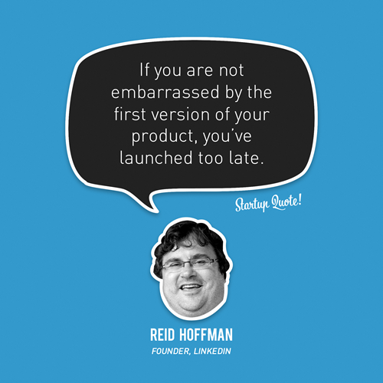
http://startupquote.com/post/855482768
Notes:
RM
In consideration of the MVP technique – one thing I notice a lot when introducing the concept to clients is there is a tendency to err on the side of caution when considering what should be in the MVP because they are afraid to release something too early. While I think a pragmatic approach is always in order, I really like this quote from Reid Hoffman because for me it sums up a good default position to have when considering an MVP.

Slide 19
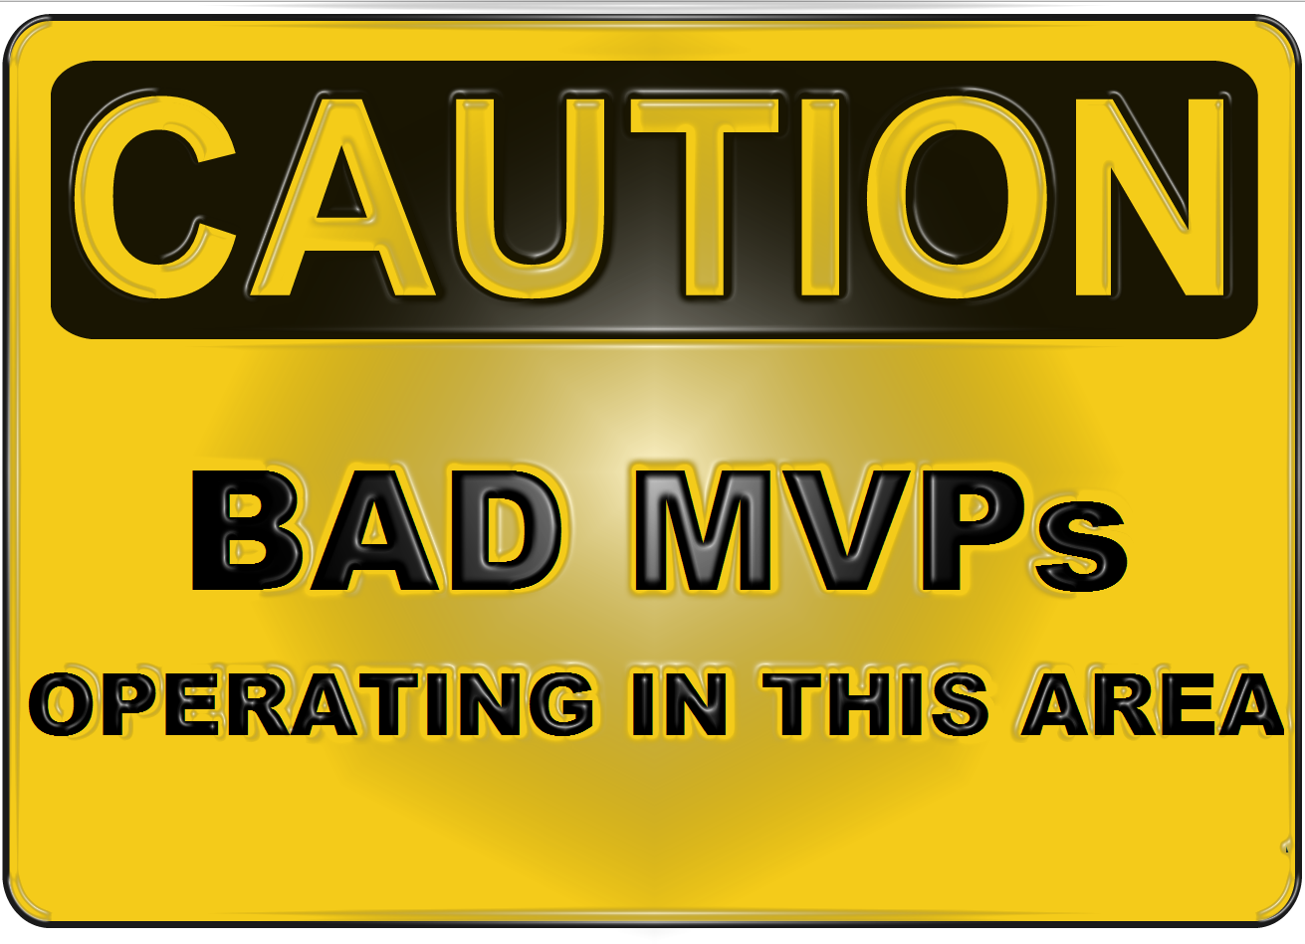
Notes:
JP
Vanity Metrics - Eric Reis
Minimal Marketable product != MVP
Fear of releasing to REAL customers (see next slide)
“The minimum viable product is that version of a new product which allows a team to collect the maximum amount of validated learning about customers with the least effort.”
Bad MVPs
Internal Releases – Releasing to internal users when those users are not your target customers.
Large MVPs – MVPs that contain pet feature or unnecessary features. Consider each feature being an MBP
Vanity Metrics – Only looking at metrics that confirm your hypothesis, Gross metrics e.g. Gross Profit are usually bad examples of metrics as they can be influenced in many ways and can hide the real performance of your MVP
“But.. MVP = Crap half baked product”
Sure when done badly. There is no magic solution other than to try and collected VALIDATED LEARNING so you need to get creative.
Consider exposing your MVP to early adopters but be careful that these adopters are real customers. Be aware that of the biases that early adopters often have.
Consider smote tests such as click throughs to “Register your interest” pages, but don’t go too far - please consider your customer they are not guinea pigs that will put themselves out to confirm your MVP.
Consider concierge services – build a human system to prove an idea in the small scale, and then look at using technology to scale. This approach is often overlooked by established organisations but ironically is the mechanism by which many companies were seeded.

Slide 20
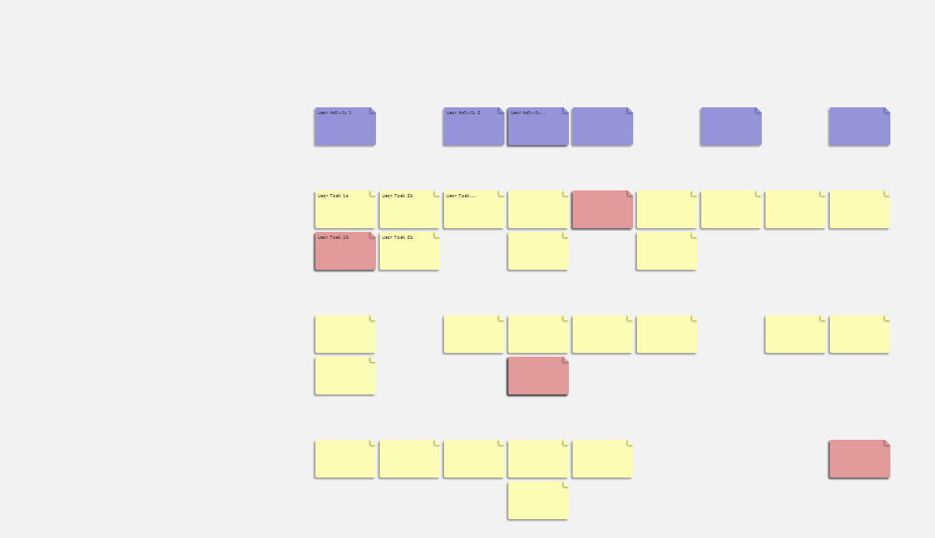
User Story Mapping
Story Mapping
Notes:
RM:
Story mapping is a fairly “old” technique now and I’ve personally been using it for a number of years to help map out and understand initial backlogs at the start of projects.
Story maps are really helpful to visualise an entire product in a way that is understandable by stakeholders by structuring stories in terms of the goals they accomplish and ordered in a horizontal logical order (usually chronologically from a user’s perspective). Then to get someone up to speed on the map you can simply "walk the map“.
I’ve found that this technique significantly helps elicit quick understanding about an entire product and importantly helps stakeholders identify missing or incorrect functionality. This makes sense because having a visual, logic display is clearly going to be more effective than a stack of cards.
The story map technique is also really helpful for initial release planning and prioritisation by allowing for vertical organisation by priority to form swimlanes.
JP:
Great starting point
Gets Business 'people' involved early
Can be used to identify MVP

Slide 21
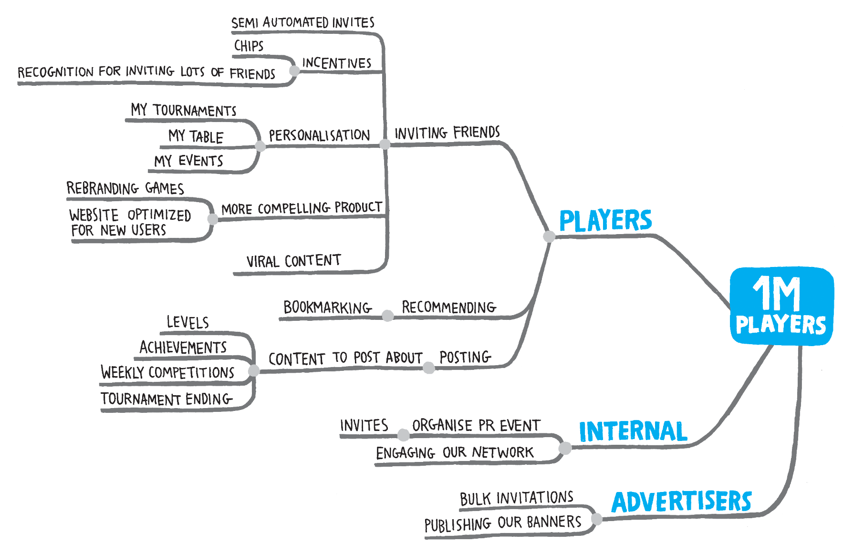

“It might sound like common sense to know this upfront, but from my experience very few people working on delivery know the actual expected business objectives”
Goyko Adzic
www.impactmapping.org
Notes:
JP
Projects often start with a feature or solution in mind. A feature list or backlog is created and development begins.
Impact mapping is a collaboration and product discovery tool that encourages people to focus on achieving goals rather than delivering software. It is a useful strategic technique that clearly frames our objectives and helps identify ideas and assumptions that we may otherwise not recognise.
Impact mapping use useful for identifying alternatives that may be cheaper and less risky. It is useful in identifying experiments/MVPs that we can use to test our assumptions and see whether these are having the effect that we assumed they would.
Supports frequent, iterative releases to measure progress.
Helps to communicate the BIG picture to all stakeholders, aligning expectations.
WHY? Start with Goal, why are we doing this? If an organisation is a profit organisation then consider defining this in terms of financial goals.
WHO? Next define the actors who may influence the goal.
HOW? Define the behaviours of the actors and how these behaviours contribute or hinder our ability to deliver the goal. It is useful to think about how behaviours need to change.
WHAT? Only once we understand actors behaviours do we consider features we may be able to deliver or actions that we can take to encourage the behaviour we require. These can be broken down further if required.
Impact maps solve these common problems:
Scope Creep – We measure when the main deliverable is reached and stop working on it.
Wrong Solutions – Easy to spot solutions looking for a problem, over engineering and complex solutions. Encourages us to try simpler solutions first.
Pet Features – If a feature cannot be attributed to the intended goal then it will not feature on the map.
Wrong Assumptions – It be comes clear and highly visible when our assumptions are not creating the impact we expected. Time to rethink or try something else.
Ad-hoc prioritisation – Ensures we are always working on the features that we believe will have the highest impact.

Slide 22
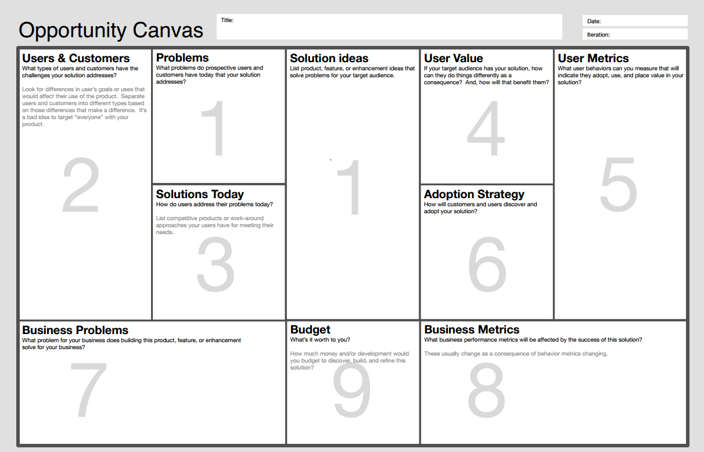
Jeff Patton - http://comakewith.us/opportunity-canvas/
Notes:
JP
Great for rationalising and challenging existing opinions and focussing on metrics upfront. An opportunity canvas is a great tool to get everyone on the same page. It helps stimulate discussions that are otherwise overlooked. Everyone on the project should understand the reasons why we are doing this piece of work.
It answers What, How, Who.
How to use the Map
Start at #1 – Ideally stating the problems that your target users have. But the world is not ideal often you will find yourself presented with a solution looking for a problem. That’s not to say the solution is bad but we can use the opportunity canvas to try and validate these solutions. In this case start with the Solution Ideas and then list the problems that the solution solves.
Work your way though the map to stimulate discussion and alternatives.
Ways to read the map:
1 to 9 is the logical path through the canvas for many companies.
Left to right – Now to Later
Top to Bottom – Users needs to Business Needs.
Consider building an opportunity canvas for each milestone or MVP.

Slide 23
Learning Based Culture
1. Idea / Experiment
Pivot |Continue | Stop
4. Learn
2 .Build
3. Measure
Based on work from Eric Reis, David Joyce
Notes:
RM
Just as we discussed earlier in the presentation – the strategic techniques we’ve covered also help to reduce feedback loops.
This acknowledges that risk starts where knowledge ends, so to minimise risk and potential waste organisations should use learning and knowledge to justify all decisions at every level of the business – technical, business and strategic.

Slide 24
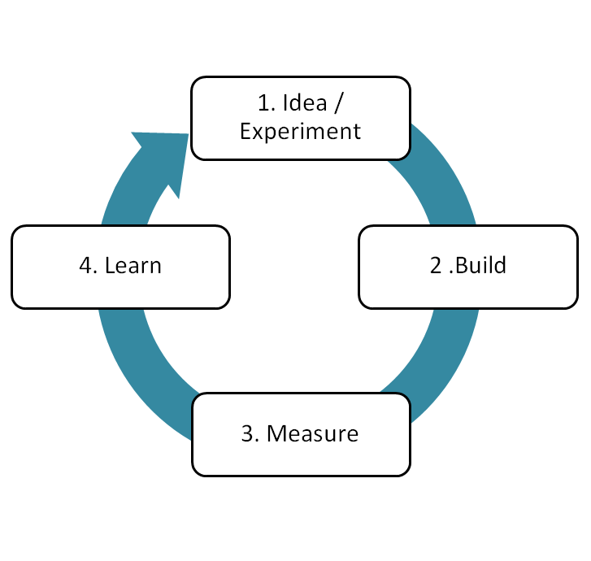
Learning Based Culture
TECHNICAL
Continuous Integration
Deployment Pipelines
Technical Metrics
BUSINESS
A/B Testing
Continuous Delivery
Usage Analytics
STRATEGIC
Impact Mapping
MVPs instead of projects
Business Goals!
Notes:
RM
We think that the term “learning based culture” nicely sums up this notion and logically includes the fact that the technical and business agility that a business has empowers the business to drive all learning and decisions from a strategic level.
There is a particularly good talk about using validated learning to drive strategic goals by David Joyce in his talk about the Agile PMO, which we highly encourage you to watch as further research.

Slide 25
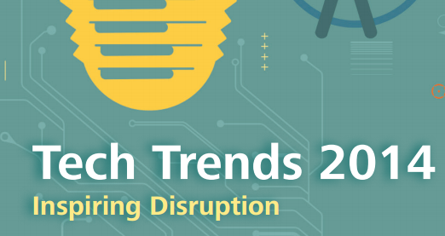
“CIO as Venture Capitalist”
Notes:
JP
http://dupress.com/articles/2014-tech-trends-cio-venture-capitalist/
"CIO as Venture Capitalist"
Earlier this year Deloitte published their tech trends for 2014, the first item was entitled "CIO as a venture capitalist"
"CIOs who want to help drive business growth and innovation will likely need to develop a new mindset and new capabilities. Like venture capitalists, CIOs should actively manage their IT portfolio in a way that drives enterprise value and evaluate portfolio performance in terms that business leaders understand— value, risk, and time horizon to reward. CIOs who can combine this with agility and align the desired talent can reshape how they run the business of IT."
This shows how the industry is recognizing the need to look at strategic agile thinking. I also describes the idea that CIOs and decision makes should start to think about investments rather than projects. e.g. rather than start a $100K project, think about investing $100K, what will provide the best returns? How can I balance risk?
Find more references to investment analogy
Other people are thinking about do this… we believe there is a significant opportunity to gain competitive advantage with this thinking.

Slide 26
Questions?
Jess Panni
Lead Consultant
jess.panni@readify.net
@jesspanni
Rob Moore
Lead Consultant
rob.moore@readify.net
@robdmoore
Notes:
JP
Stategic agility more valuable than technical aagility.
But its hard - cultural change
Rewards, - competitive advantage, minimise waste, building a healthy profitable business.

Slide 27
Links - Presentations
How Kanban Helps Us Move Beyond Traditional PMO - David Joyce
http://vimeo.com/43036371
Continuous Delivery - Martin Fowler, Jez Humble
http://yow.eventer.com/yow-2011-1004/continuous-delivery-by-martin-fowler-and-jez-humble-1062
Etsy’s Product Development with Continuous Experimentation – Frank Harris and Nellwyn Thomas
http://qconsf.com/sf2012/dl/qcon-sanfran-2012/slides/FrankHarris_and_NellThomas_ProductDevelopmentWithContinuousExperimentation.pdf
Continuous Design - Mary Poppendieck
http://yow.eventer.com/yow-2011-1004/continuous-design-by-mary-poppendieck-1027
Feedback Makes Everything Better: Understanding the Software Engineering Process
- Bjorn Freeman-Benson
http://yow.eventer.com/yow-2011-1004/feedback-makes-everything-better-understanding-the-software-engineering-process-by-bjorn-freeman-benson-1061
A/B Testing: Lessons Learned at Spotify – Danielle Jabin
http://www.infoq.com/presentations/ab-testing-spotify

Slide 28
Links - Books
Continuous Delivery – Jez Humble, David Farley
http://www.amazon.com/dp/0321601912?tag=contindelive-20
Impact Mapping – Gojko Adzic
http://impactmapping.org/book.php
The Lean Startup – Eric Reis
http://theleanstartup.com/
Theories of Work – David Joyce
http://www.theoriesofwork.com/
Developmental Sequence in Small Groups – Bruce Tuckman
http://aneesha.ceit.uq.edu.au/drupal/sites/default/files/Tuckman%201965.pdf

Slide 29
Links - Case Studies / Articles
Continuous Deployment: The Dirty Details - Mike Brittain
http://channel9.msdn.com/Events/ALM-Summit/ALM-Summit-3/Continuous-Deployment-The-Dirty-Details
Continuous Deployment at Etsy - Ross Snyder
http://www.slideshare.net/500startups/ross-synder-etsy-sxsw-lean-startup-2013
Continuous Deployment: Etsy Case Study - Chad Dickerson
https://www.udemy.com/lectures/continuous-deployment-etsy-case-study-chad-dickerson-73944
Interview with Michael Rembetsy on Etsy's PCI-DSS implementation
http://www.youtube.com/watch?v=nrDH5MVwVN4
Actionable Metrics - Enabling Decision-Making in Netﬂix’s Decentralized Environment - Roy Rapoport
http://www.infoq.com/presentations/Netflix-Metrics
New approaches to IT service management – www.cio.com.au
http://www.cio.com.au/article/529820/new_approaches_it_service_management

Slide 30
Links - Case Studies / Articles
10-deploys-per-day-dev-and-ops-cooperation-at-flickr - John Allspaw and Paul Hammond
http://www.youtube.com/watch?v=LdOe18KhtT4
How We Determine Product Success - John Ciancutti
http://techblog.netflix.com/2011/01/how-we-determine-product-success.html
Consumer Science and Product Development at Netflix - OSCON 2012 - Matt Marenghi
http://www.slideshare.net/mattmarenghi/consumer-science-and-product-development-at-netflix
CIO as venture capitalist - Tom Galizia & Chris Garibaldi
http://dupress.com/articles/2014-tech-trends-cio-venture-capitalist/
Why IT leaders should adopt a venture capitalist approach - Richard Atherton
http://www.computerweekly.com/opinion/Why-IT-leaders-should-adopt-a-venture-capitalist-approach

